Slide 1
Clinical Trials : Phase I
By : Anis Bourbia

Slide 2
1) The objectif of phase I
It’s to find the most affective dose with an estimated toxicity probability the closest to the toxicity target (P(DLT) )so we can move on to the next phase
The P(DLT) is always defined by clinicians for each clinical trial

Slide 3
2) CRM methode :
We take 25 to 30 patients and we fixe the P(DLT) that we aim for ( we took 20% in our example ) and the number of doses that we are going to explore ( we have 6 doses in this example )

Slide 4
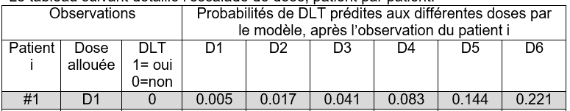
The steps followed :
2 Patients treated at dose d_{i}
Observe the DLT (yes / no ) (if one of them is yes we test with another 2 patients and if one of those two also has DLT then we reject that dose )
Re-evaluate the proba of DLT at each dose level with Bayesian or frequentist estimation

Slide 5
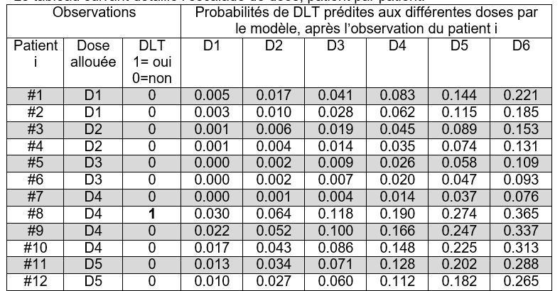
4) The dose level to be allocated to the next patient is that associated with an estimated toxicity probability the closest to the toxicity target

Slide 6
3) The two models used in the CRM methode :
1. Power (Empiric) model
2. Logistic model

Slide 7
4) The results
In this procedure we had 2 patients for each of the doses 1,2 and 3 with 0 DLT observed and 4 patients for the doses 4 and 6 with 1 DLT observed in dose 4 and 2 DLT observed in dose 6 and 11 patients for dose 5 with 1 DLT observed
Recommended dose is : D5
It has p(DLT)=0,193 the closest one to 0,2 (the p(DLT) that we aim for from the beginning) with a confidence interval of (0,373-0,064)

Slide 8
5) Other escalation dose methode :
We have 3+3 methode which it doesnt require any statistics , easy to Implement , easy to understand , and we can stop the trial relatively quickly
But does it give the same results as the CRM methode : NO
Why : because it ignores most of the data and it gives imprecise estimate of the recommended dose

